Slide 1

Customer Segmentation
G Coffee Shop
Arya Adhy
Data Science Batch 38
Final Project
Notes:
Photo by rawpixel on Unsplash

Slide 2
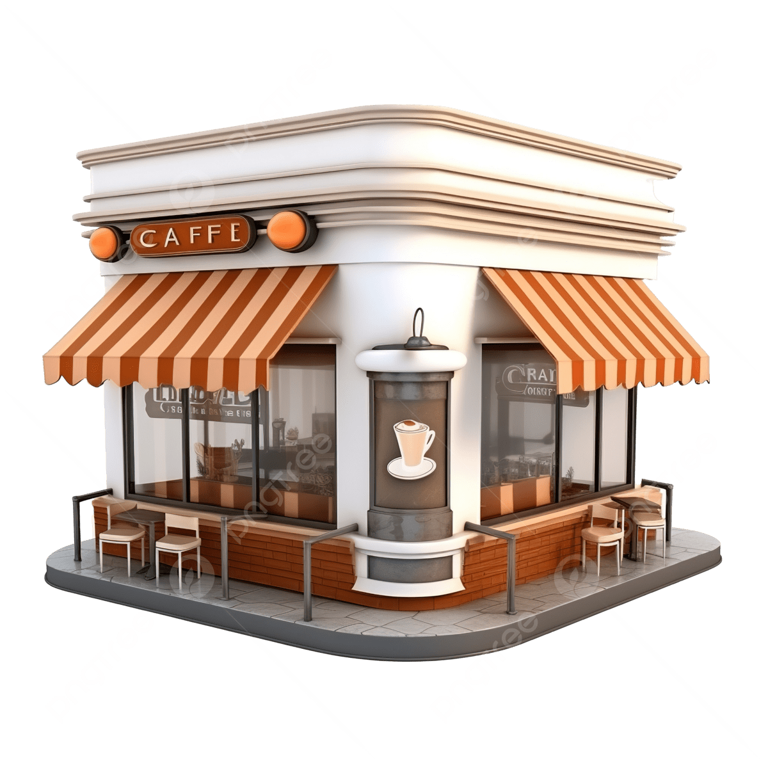
Data Background
A synthetically generated, comprehensive record of coffee shop transactions spanning July 2023 to June 2025. offering a unique lens into the evolving dynamics of customer engagement and purchasing behavior.

Slide 3
Outline
Objective
Exploratory Data Analysis
RFM Customer Segmentation
Business Recommendation

Slide 4
Objective
To identify and categorize customers into distinct segments based on their transactional behavior (Recency, Frequency, and Monetary Value).
Analyze Customer Lifetime Value (CLV) and Revenue Growth by identifying and focusing resources on the most profitable customer segments.
Suggest the Actionable Strategy to the most profitable customer segments.

Slide 5

Exploratory Data Analysis
Dataset Information
Preparation and Preliminary Insight
Notes:
Photo by rawpixel on Unsplash

Slide 6
EDA
transactions
transaction_Item
stores
menu_items
transaction_id
store_id
payment_methode
voucher_id
user_id
Original_amount
discount_applied
final_amount
created_at
transaction_id
item_id
quantity
Unit_price
subtotal
created_at
Store_id
Store_name
Street
Postal_code
City
State
Latitude
longitude
item_id
item_name
category
price
is_seasonal
available_from
available_to
Payment_methode
vouchers
Customer segmentation using the RFM model requires a customer ID and supporting data for Recency, Frequency, and Monetary value. Therefore, transaction data will be used.
Methode_id
Methode_name
category
Voucher_id
Voucher_code
Discount_type
Discount_value
Valid_from
Valid_to
user_id
gender
birthdate
register_at

Slide 7








Pipeline
I’m here
Handling Duplicated Rows
Handling Missing Values
Handling Outliers
-
RFM Feature Engineering , Scoring and Customer Segmentation
Dashboard & Visualization
Insight & Decision Making

Slide 8
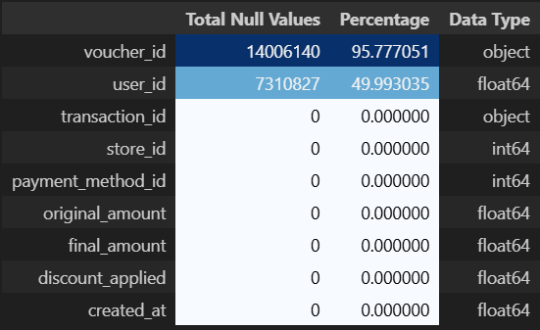
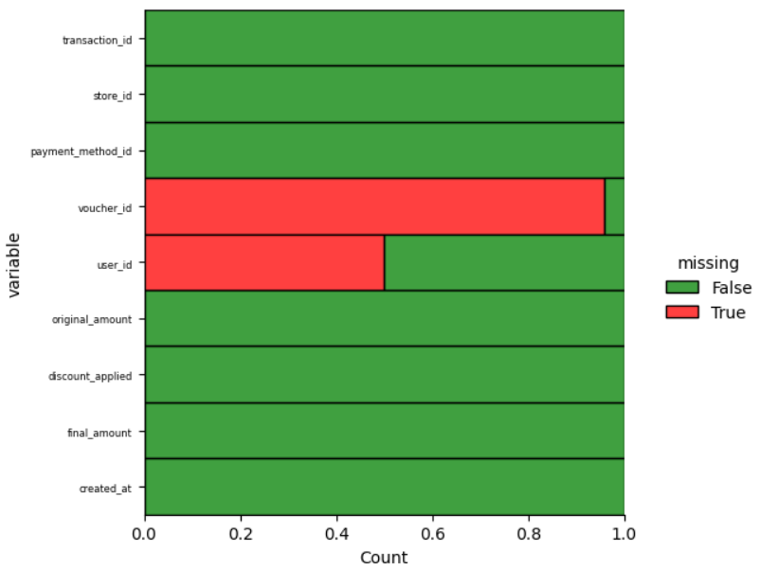
EDA
Transactions Dataset
Customer Segmentation Requirement
user_id : Use as customer identification in Customer segmentation
transaction_id : Data use for calculating Frequency
Final_amount : Data use for calculating Monetary
created_at : Data use for calculating Recency
The dataset contains 9 columns and 14,623,691 rows.
No Duplicate Value
Keep data with Customer ID
Remove data without Customer ID

Slide 9

Pipeline
Where are you?
Handling Duplicated Rows
Handling Missing Values
Handling Outliers
-
RFM Feature Engineering , RFM Scoring and Customer Segmentation
Dashboard & Visualization
Insight & Decision Making

Slide 10
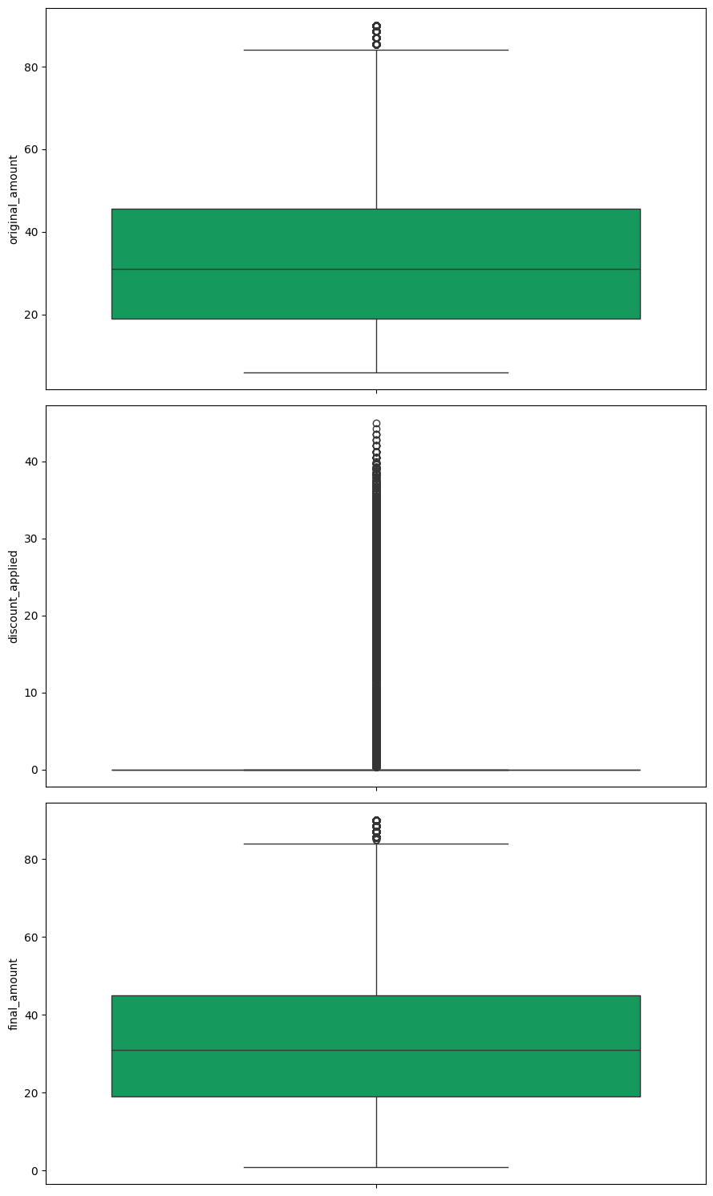
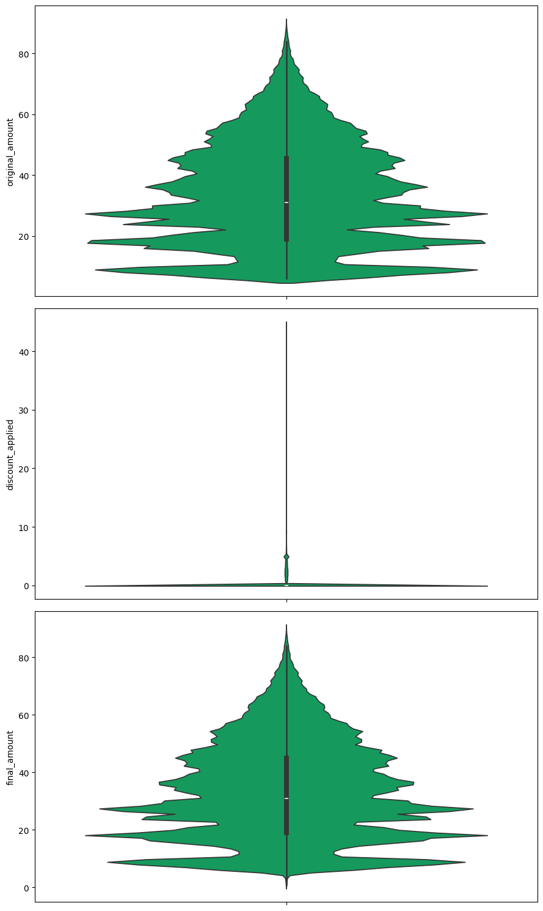
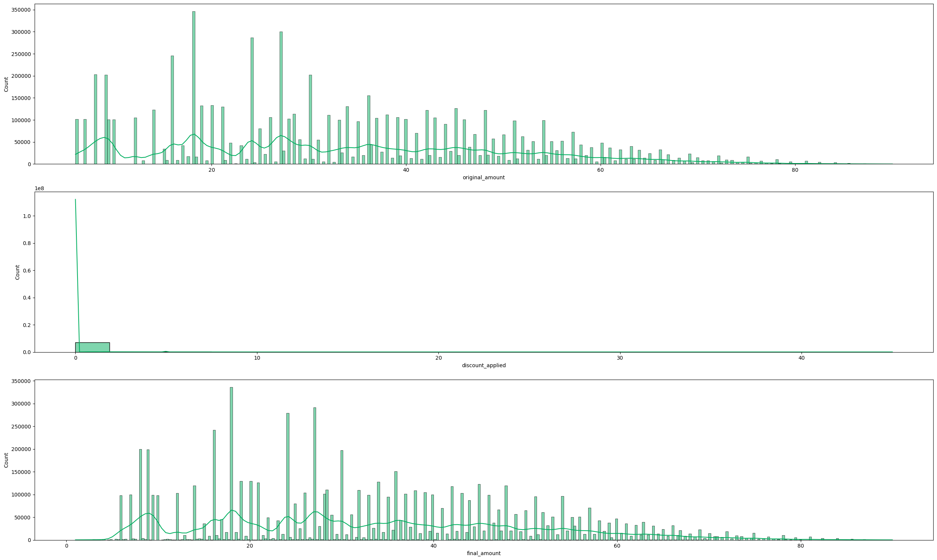
EDA
final_amount outlier identification, suggestion and preliminary insight
Max Value = 90
Upper = 85.25
Final_amount Outlier value not to far from the upper limit and this value represent user spending
Final_amount distribution skewness is right skew but moderately normal distribution
User spending highest frequency in the distribution is located in the ~RM10 - RM30 range.
Moderately Normal Distribution (Symmetric)

Slide 11

RFM Customer Segmentation
RFM Feature Engineering
RFM Scoring
Customer Segment Classification
Notes:
Photo by rawpixel on Unsplash

Slide 12

Pipeline
Handling Duplicated Rows
Handling Missing Values
Handling Outliers
-
Fiuh..Where are they?
RFM Feature Engineering , RFM Scoring and Customer Segmentation
Dashboard & Visualization
Insight & Decision Making

Slide 13



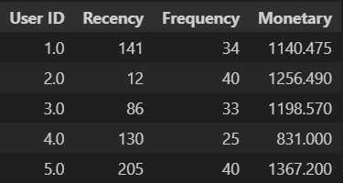
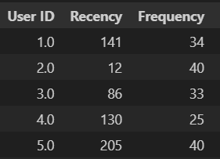
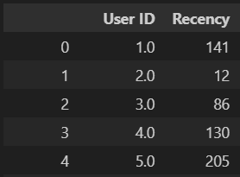
RFM Customer Segmentation
RFM Feature Engineering
Recency
Frequency
Monetary
created_at
Date and time values
Created From Distinct count of transaction_id per user_id
Total Money Spend/user_id
date created_at
Date values
Recency
date_created_at - lates date

Slide 14
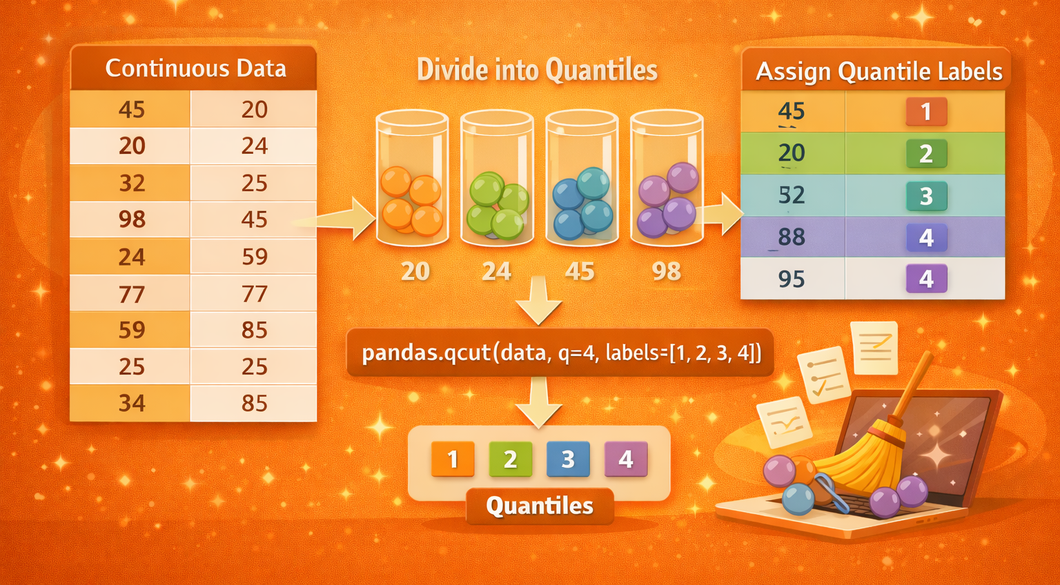
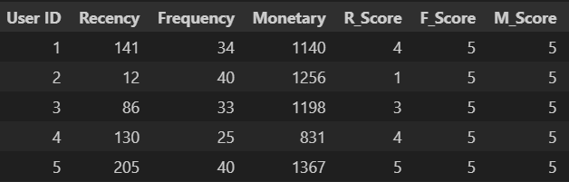
RFM Customer Segmentation
RFM Feature Scoring
Recency
Frequency
Monetary
Classification | Score 1 | Score 5
Recency | Good | Poor
Frequency | Poor | Good
Monetary | Poor | Good

Slide 15
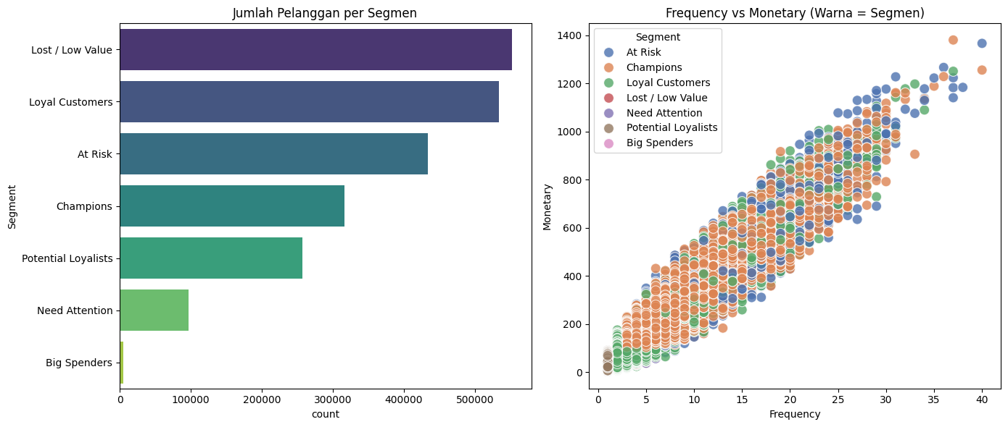
RFM Customer Segmentation
Customer Segmentation
Segment | Criteria | Description | Business Strategy
Champion | R ≥ 4, F ≥ 4, M ≥ 4 | Best customers who purchase very recently, very frequently, and spend the most. | VIP rewards, exclusive offers, early access to products
Loyal Customer | R ≥ 3, F ≥ 3, M ≥ 4 | Consistent and reliable customers with high spending and strong engagement. | Loyalty programs, personalized recommendations, upselling
Potential Loyalists | R ≥ 4, F ≥ 2, M ≥ 4 | Recent high-value customers with growing purchase frequency. | Engagement campaigns, personalized promotions, repeat purchase incentives
Big Spender | R ≥ 3, M ≥ 4 | Customers who spend a lot per transaction but purchase less frequently. | Premium offers, VIP treatment, exclusive deals
Need Attention | R ≥ 2, F ≥ 2, M ≥ 2 | Moderately engaged customers with average recency, frequency, and spending. | Targeted promotions, engagement reminders
At Risk | R ≤ 2, F ≥ 3, M ≥ 3 | Previously valuable customers who have not purchased recently. | Win-back campaigns, personalized discounts
Lost / Low Value | R ≤ 2, F < 3, M < 2 | Inactive or low-contribution customers. | Low-cost reactivation or deprioritize

Slide 16
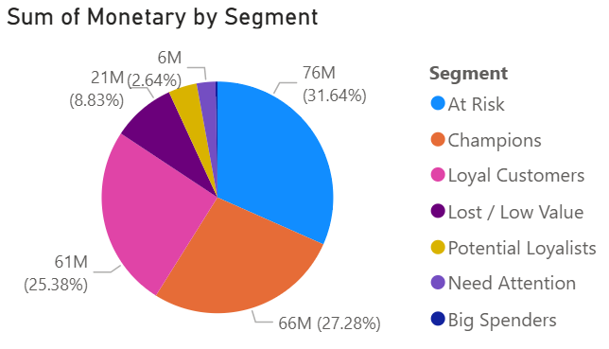
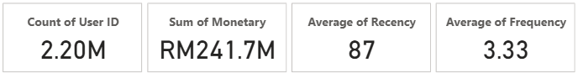
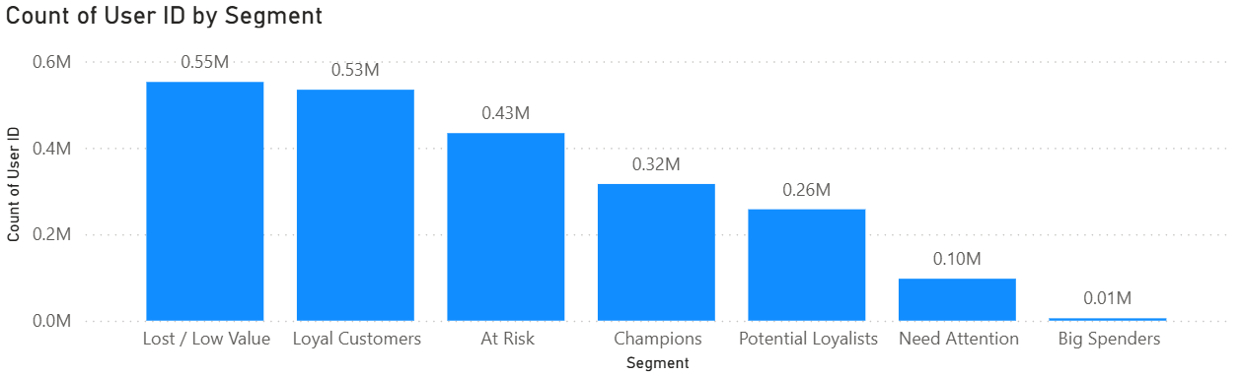
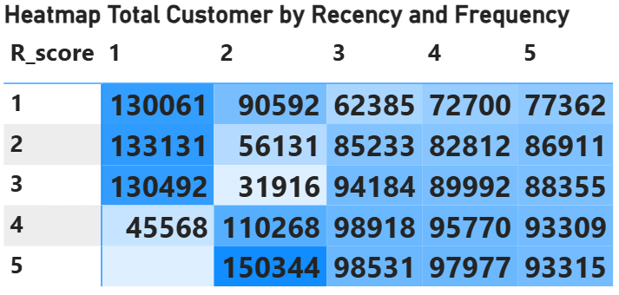
Dataset Quick Summary

Slide 17
Business Recommendation
Customer Segmentation Dashboard
Business Recommendation
Notes:
Photo by rawpixel on Unsplash

Slide 18
Pipeline
Handling Duplicated Rows
Handling Missing Values
Handling Outliers
-
RFM Feature Engineering , RFM Scoring and Customer Segmentation
Dashboard & Visualization
Insight & Decision Making

Slide 19
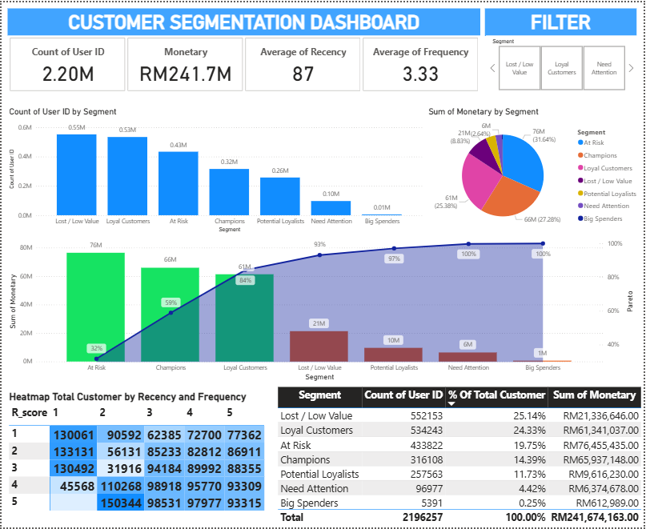
Business Recommendation
Customer Segmentation Dashboard
General Information and Filter
Bar Chart and Pie Chart
Pareto Diagram
Table and heatmap

Slide 20
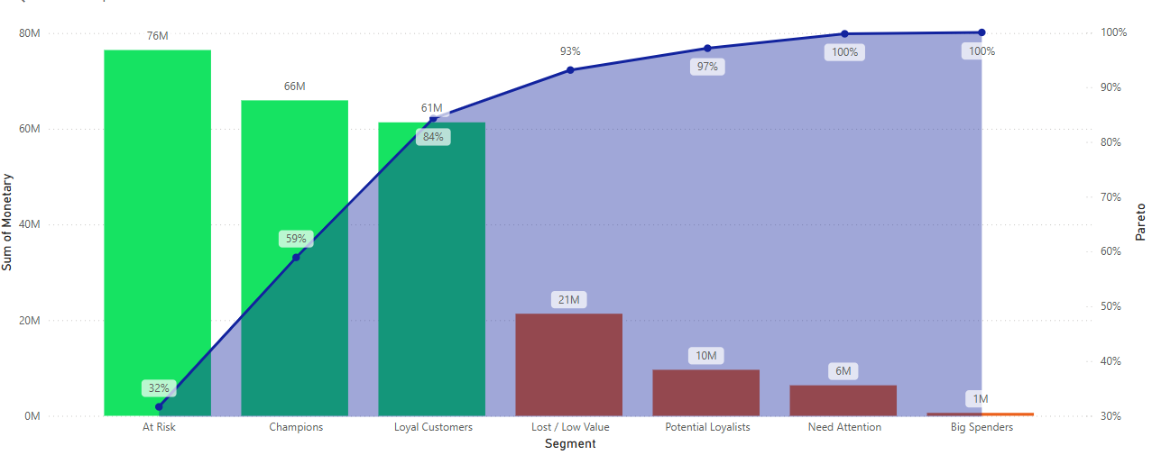
Business Recommendation
Business Recomendation
Analyze Customer Lifetime Value (CLV) and Revenue Growth by identifying and focusing resources on the most profitable customer segments.
Focus Customer based on profitable
Segment | Criteria | Description | Business Strategy
Champion | R ≥ 4, F ≥ 4, M ≥ 4 | Best customers who purchase very recently, very frequently, and spend the most. | VIP rewards, exclusive offers, early access to products
Loyal Customer | R ≥ 3, F ≥ 3, M ≥ 4 | Consistent and reliable customers with high spending and strong engagement. | Loyalty programs, personalized recommendations, upselling
At Risk | R ≤ 2, F ≥ 3, M ≥ 3 | Previously valuable customers who have not purchased recently. | Win-back campaigns, personalized discounts
Suggest the Actionable Strategy to the most profitable customer segments.

Slide 21
THANK YOU
Notes:
Photo by rawpixel on Unsplash

